Slide 1


PharmaLock
What is the Use Case?
01 use case
Team Lötschberger
Feline Weger Lukas Kamber Semih Eryilmaz Sivanajani Sivakumar

Slide 2
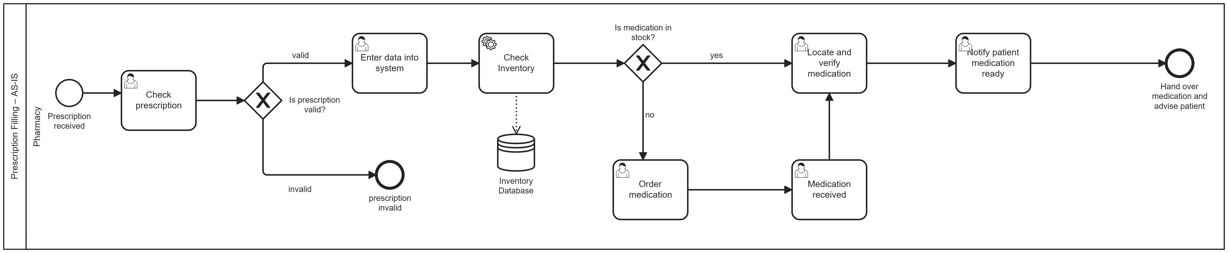
As-is process
What is the Use Case?
01 use case
Team Lötschberger

Slide 3
As-is process
What is the Use Case?
01 use case
Team Lötschberger

Slide 4
As-is process
What is the Use Case?
01 use case
Team Lötschberger

Slide 5
As-is process
What is the Use Case?
02 Pharmalock
TO-BE process
01 use case
Team Lötschberger

Slide 6
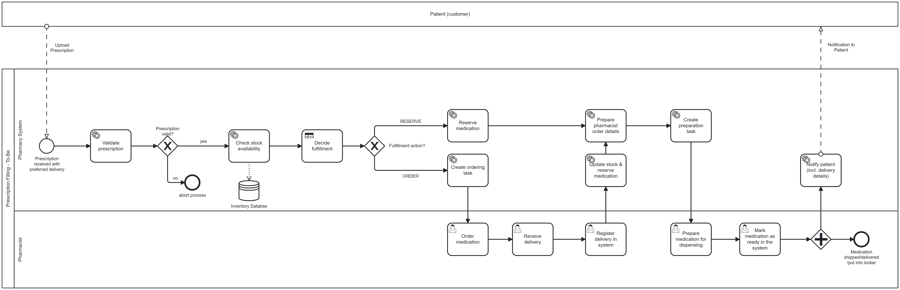
02 Pharmalock
TO-BE process
03 Database
03 Database
Database
Team Lötschberger

Slide 7
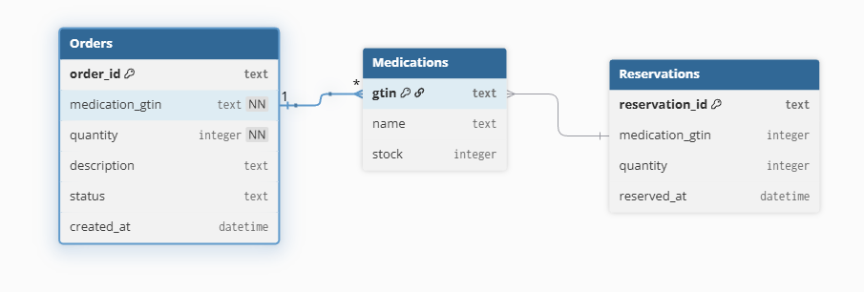
03 Database
04 VIDEO
Team Lötschberger

Slide 8
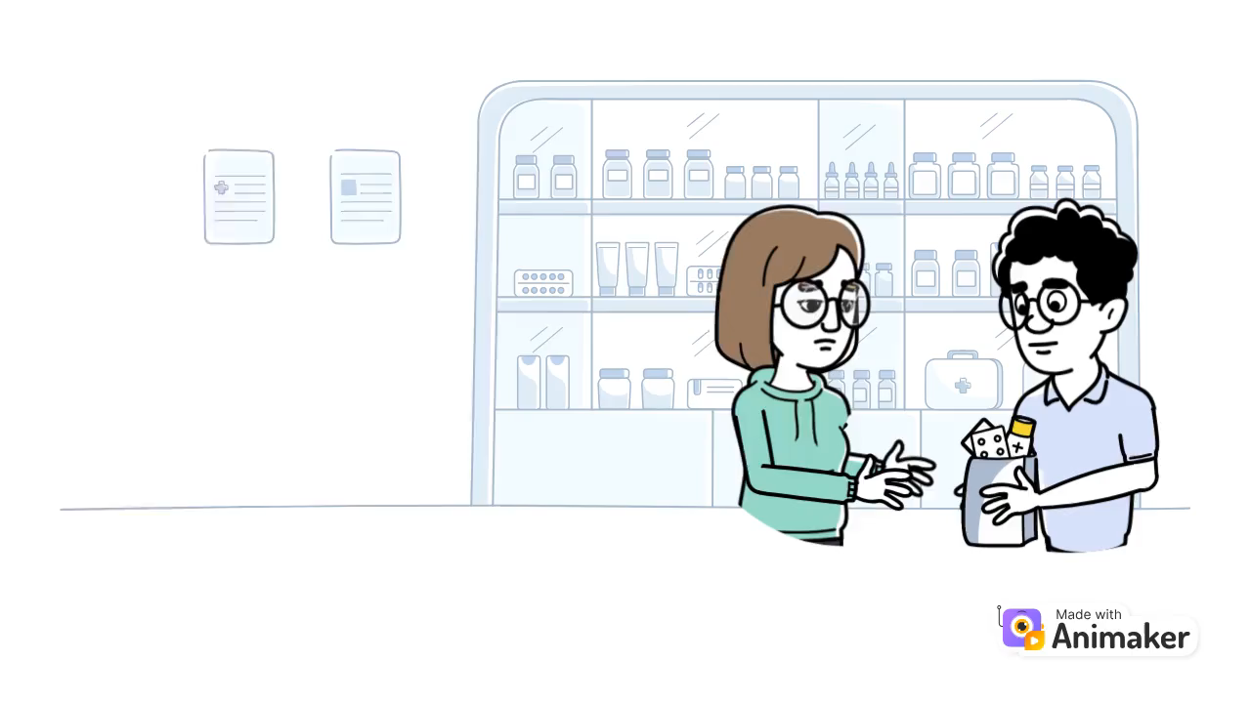
04 VIDEO
THANK
You
Does anyone have any questions?
Team Lötschberger
Team Lötschberger

Slide 9
THANK
You
Does anyone have any questions?
Team Lötschberger

